Slide 1
Disorders of Childhood
Classification and Diagnosis of Childhood Disorders
F. Muvea

Slide 2
Classification and Diagnosis of
Childhood Disorders
Developmental psychopathology
  Studies disorders within the context of normal child development
Relationship between child and adult psychopathology
  Some disorders are unique to children
    e.g., separation anxiety disorder
  Some disorders are primarily childhood disorders, but may continue into adulthood
    e.g., attention-deficit/hyperactivity disorder
  Some disorders are present in children and adults
    e.g., depression

Slide 3
Classification and Diagnosis of
Childhood Disorders
DSM-5 splits childhood disorders into two chapters:
  Neurodevelopmental Disorders
  Disruptive, Impulse Control, and Conduct Disorder
DSM-5 has new names for disorders
  e.g., mental retardation is now called intellectual disability (intellectual developmental disorder)

Slide 4
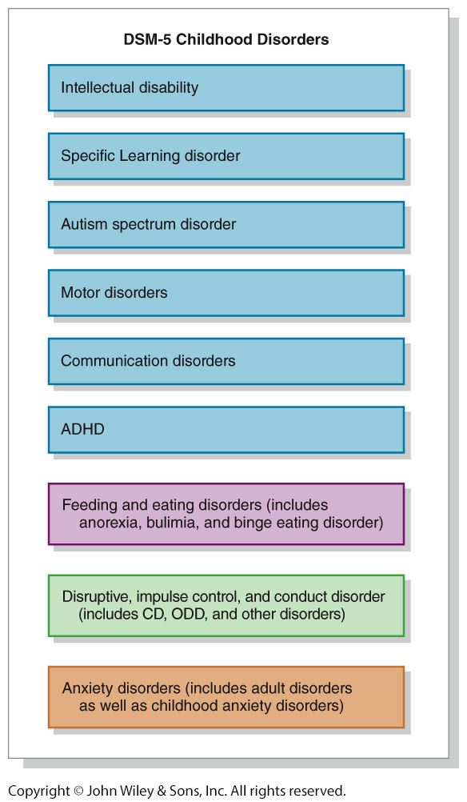

Slide 5
Classification and Diagnosis of
Childhood Disorders
Externalizing disorders
  Characterized by outward-directed behaviors
  Noncompliance, aggressiveness, overactivity, impulsiveness
    Includes:
      attention-deficit/hyperactivity disorder,
      conduct disorder, and
      oppositional defiant disorder
  More common in boys

Slide 6
Classification and Diagnosis of
Childhood Disorders…
Internalizing disorders
  Characterized by inward-focused behaviors
    Depression,
    anxiety,
    social withdrawal
  Includes childhood anxiety and mood disorders
  More common in girls

Slide 7
Attention-Deficit/Hyperactivity Disorder - ADHD
Excessive levels of activity
  Fidgeting, squirming, running around inappropriately, incessant talking
Distractibility and difficulty concentrating
  Makes careless mistakes, cannot follow instructions, forgetful
May have difficulty with peer interactions

Slide 8
DSM-5 Criteria for
Attention-Deficit/Hyperactivity Disorder
Either A or B:
A. Six or more manifestations of inattention present for at least 6 months to a maladaptive degree and greater than what would be expected given a person’s developmental level,

Slide 9
DSM-5 Criteria for
Attention-Deficit/Hyperactivity Disorder…
Manifestations of inattention
e.g.,
  careless mistakes,
  not listening well,
  not following instructions,
  easily distracted,
  forgetful in daily activities

Slide 10
DSM-5 Criteria for
Attention-Deficit/Hyperactivity Disorder …
B. Six or more manifestations of hyperactivity-impulsivity present for at least 6 months to a maladaptive degree and greater than what would be expected given a person’s developmental level,

Slide 11
DSM-5 Criteria for
Attention-Deficit/Hyperactivity Disorder…
Manifestations of hyperactivity-impulsivity
e.g.,
  fidgeting,
  running about inappropriately (in adults, restlessness),
  acting as if “driven by a motor,”
  interrupting or intruding,
  incessant talking

Slide 12
DSM-5 Criteria for
Attention-Deficit/Hyperactivity Disorder …
Several of the above present before age 12
Present in two or more settings, e.g., at home, school, or work
Significant impairment in social, academic, or occupational functioning
For people age 17 or older, only five signs of inattention and/or five signs of hyperactivity-impulsivity are required to meet the diagnosis.

Slide 13
Attention-Deficit/Hyperactivity Disorder
Three specifiers in DSM-5 to indicate which symptoms predominate
  Predominantly inattentive type
  Predominantly hyperactive-impulsive type
  Combined type
Combined is the majority of diagnoses

Slide 14
Attention-Deficit/Hyperactivity Disorder…
Differential diagnosis
  ADHD or Conduct Disorder?
  ADHD
    More off-task behavior, cognitive and achievement deficits
  Conduct Disorder
    More aggressive, behaving badly in most settings,
      Hx of antisocial parents, family hostility

Slide 15
Attention-Deficit/Hyperactivity Disorder …
ADHD often comorbid with anxiety and depression
Prevalence estimates 8 to 11% worldwide
Public policy can affect diagnosis rates
More common in boys than girls
  May be because boys’ behavior more likely to be aggressive

Slide 16
Attention-Deficit/Hyperactivity Disorder …
Symptoms persist beyond childhood
  Numerous longitudinal studies show 65 to 80% still exhibit symptoms
  60% of adults continue to meet criteria for ADHD in remission

Slide 17
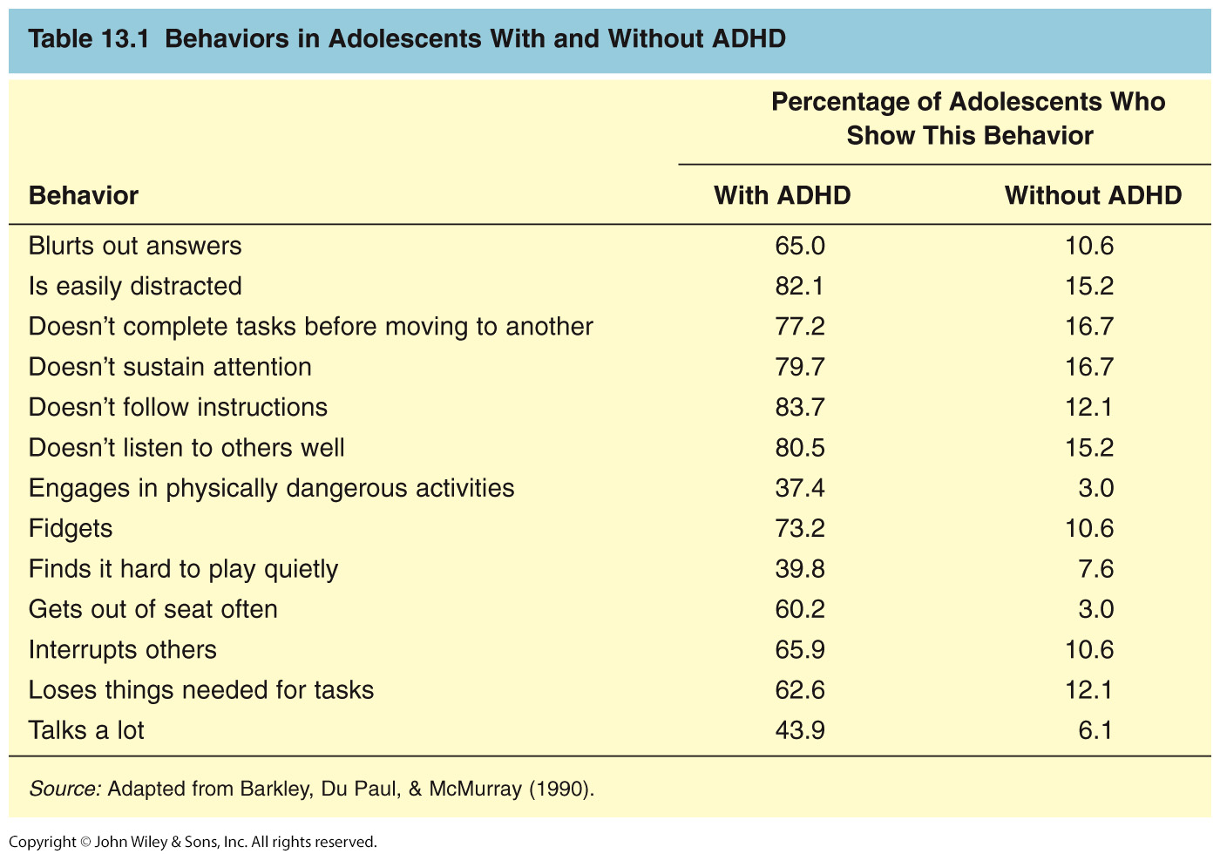
Attention-Deficit/Hyperactivity Disorder

Slide 18
Etiology of ADHD
Genetic factors
  Adoption and twin studies
    Heritability estimates as high as 70 to 80%
  Two dopamine genes implicated
    DRD4
      Dopamine receptor gene
    DAT1
      Dopamine transporter gene
        Mixed support for this gene
  Either gene associated with increased risk only when prenatal maternal nicotine or alcohol use is present

Slide 19
Etiology of ADHD …
Neurobiological factors
  Dopaminergic areas smaller in children with ADHD
    Frontal lobes, caudate nucleus, globus pallidus
  Poor performance on tests of frontal lobe function

Slide 20
Etiology of ADHD …
Perinatal and prenatal factors
  Low birth weight
    Can be mitigated by later maternal warmth
  Maternal tobacco and alcohol use

Slide 21
Etiology of ADHD …
Environmental toxins
  Limited evidence that food additives or food coloring can have a small impact on hyperactive behavior
  No evidence that refined sugar causes ADHD
  Nicotine from maternal smoking
    Exposure to tobacco in utero associated with ADHD symptoms
    May damage dopaminergic system, resulting in behavioral disinhibition

Slide 22
Etiology of ADHD …
Parent-child relationship
  Parents give more commands and have more negative interactions
  Family factors
    Interact with genetic and neurobiological factors
    Contribute to or maintain ADHD behaviors but do not cause them
>>

Slide 23
Treatment of ADHD
Stimulant medications (Ritalin, Adderall, Concerta, Strattera)
  Reduce disruptive behavior
  Improve interactions with parents, teachers, peers
  Improve goal-directed behavior and concentration
  Reduce aggression
  Effective in about 75 percent of children with ADHD but there are side effects
    Loss of appetite, weight, sleep problems

Slide 24
Treatment of ADHD …
Medication plus behavioral treatment (MTA study)
  Slightly better than meds alone
  Improved social skills whereas meds alone did not
  Three-year follow-up found superior benefits of meds did not persist

Slide 25
Treatment of ADHD …
Psychological treatment
  Parental training
  Change in classroom management
  Behavior monitoring and reinforcement of appropriate behavior

Slide 26
Treatment of ADHD …
Supportive classroom structure
  Brief assignments
  Immediate feedback
  Task-focused style
  Breaks for exercise
  >>

Slide 27
Conduct Disorder (CD)
Pattern of engaging in behaviors that violate social norms and the rights of others, and are often illegal
  Aggression
  Cruelty towards other people or animals
  Damaging property
  Lying
  Stealing
  Vandalism
  Often accompanied by viciousness, callousness, and lack of remorse

Slide 28
Disorders Related to Conduct Disorder
Intermittent explosive disorder: recurrent verbal or physical aggressive outbursts that are out of proportion to the circumstances.
  Aggression is impulsive and not preplanned

Slide 29
Disorders Related to Conduct Disorder …
Oppositional Defiant Disorder (ODD) behaviors do not meet criteria for CD (especially extreme physical aggressiveness) but child displays pattern of defiant behavior
  Argumentative, loses temper, lack of compliance, deliberately aggravates others, hostile, vindictive, spiteful, or touchy, blames others for own problems

Slide 30
Disorders Related to Conduct Disorder …
Comorbid with ADHD, learning and communication disorders
  Disruptive behavior of ODD more deliberate than ADHD
Most often diagnosed in boys but may be as prevalent in girls

Slide 31
DSM-5 Criteria for Conduct Disorder
• Repetitive and persistent behavior pattern that violates the basic rights of others or conventional social norms as manifested by the presence of three or more of the following in the previous 12 months and at least one of them in the previous 6 months:

Slide 32
DSM-5 Criteria for Conduct Disorder …
A. Aggression to people and animals, e.g.,
  bullying,
  initiating physical fights,
  physically cruel to people or animals,
  forcing someone into sexual activity

Slide 33
DSM-5 Criteria for Conduct Disorder …
B. Destruction of property, e.g.,
  fire-setting,
  Vandalism
C. Deceitfulness or theft, e.g.,
  breaking into another’s house or car,
  conning,
  shoplifting

Slide 34
DSM-5 Criteria for Conduct Disorder …
D. Serious violation of rules, e.g.,
  staying out at night before age 13 in defiance of parental rules,
  truancy before age 13
• Significant impairment in social, academic, or occupational functioning

Slide 35
Conduct Disorder (CD)
Substance abuse common
  Unclear whether it precedes or is concomitant with disorder
Comorbid with anxiety and depression
  Comorbidity rates vary from 15 to 45%
  CD precedes anxiety and depression

Slide 36
Conduct Disorder …
Prevalence
  Boys
    4 to 16%
  Girls
    1.2 to 9%

Slide 37
Conduct Disorder (CD)…
Two distinct CD types
  Life-course-persistent pattern of antisocial behavior
    10 – 15 x more common in boys than girls
  Adolescence-limited
    Maturity gap between physical maturation and rewarding adult behaviors

Slide 38
Conduct Disorder (CD)…
Follow-up longitudinal studies of life-course-persistent type show more severe problems into early adulthood, including:
  Academic underachievement
  Neuropsychological deficits
  ADHD
  Family psychopathology
  Poorer physical health
  Lower socioeconomic status (SES)
  Violent behaviors

Slide 39
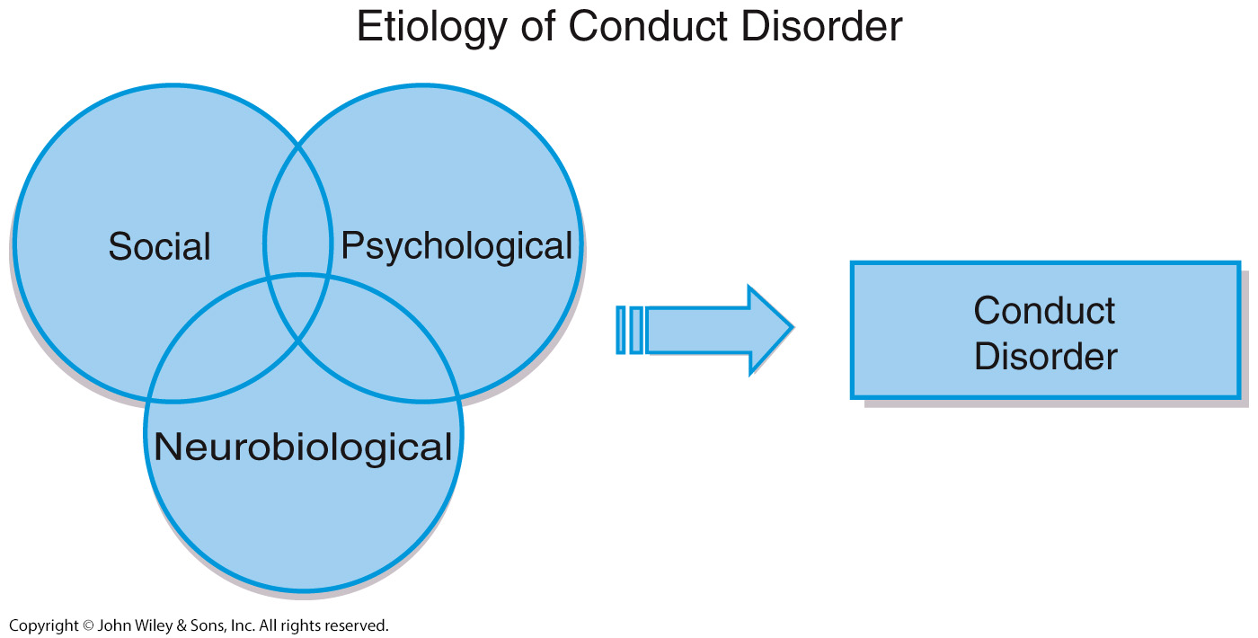
Etiology of Conduct Disorder

Slide 40
Etiology of Conduct Disorder (CD)…
Genetic factors
  Heritability likely plays a part
  Twin study data show mixed results
  Adoption studies focused on criminal behavior, not conduct disorder

Slide 41
Etiology of Conduct Disorder (CD)…
Meta-analysis of twin and adoption studies suggest 40 – 50% of antisocial behavior is heritable
  Genetics a stronger influence when behaviors begin in childhood rather than adolescence
Genetics and environment interact
  Abuse as a child PLUS low MAO-A (Monoamine oxidase A ) activity most likely to develop CD

Slide 42
Etiology of Conduct Disorder (CD)…
Neurobiological factors
  Poor verbal skills
  Difficulty with executive functioning
  Low IQ
  Lower levels of resting skin conductance and heart rate suggest lower arousal levels

Slide 43
Etiology of Conduct Disorder (CD)…
Psychological factors
  Deficient moral development, especially lack of remorse
  Modeling and reinforcement of aggressive behavior
  Harsh and inconsistent parenting
  Lack of parental monitoring
  Cognitive bias: Neutral acts by others perceived as hostile

Slide 44
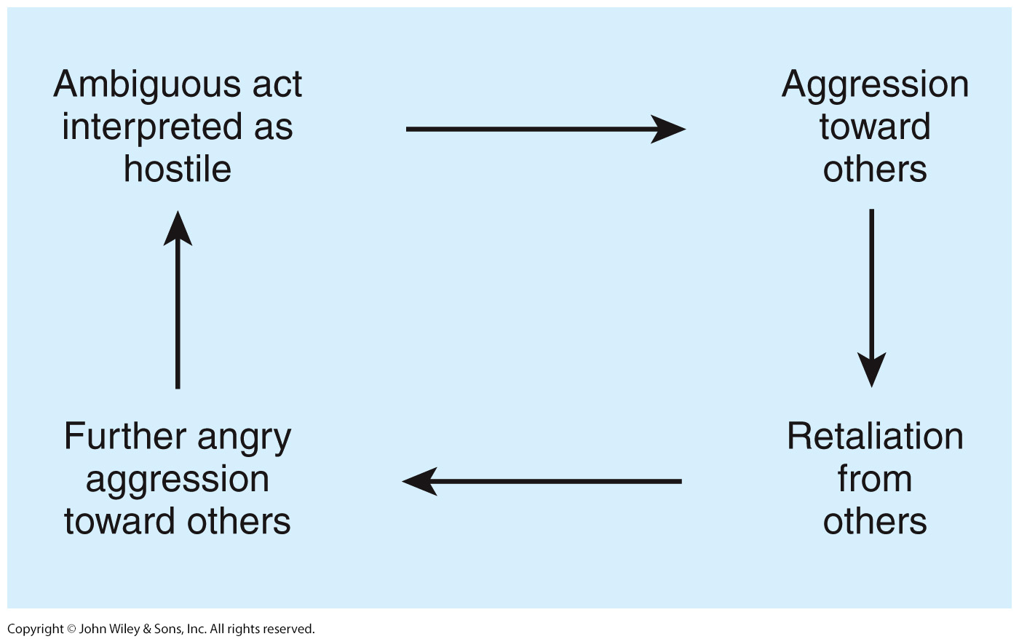
Dodge’s Cognitive Theory of Aggression

Slide 45
Etiology of Conduct Disorder (CD)…
Peer influences associated with CD
  Rejection by peers
  Affiliation with deviant peers
Sociocultural factors
  Poverty
  Urban environment
  >>

Slide 46
Treatment of Conduct Disorder
Family interventions
  Family check-ups (FCU) associated with less disruptive behavior
  Parental management train (PMT)
    Teach parents to reward prosocial behavior
Multisystemic therapy
  Deliver intensive community-based services

Slide 47
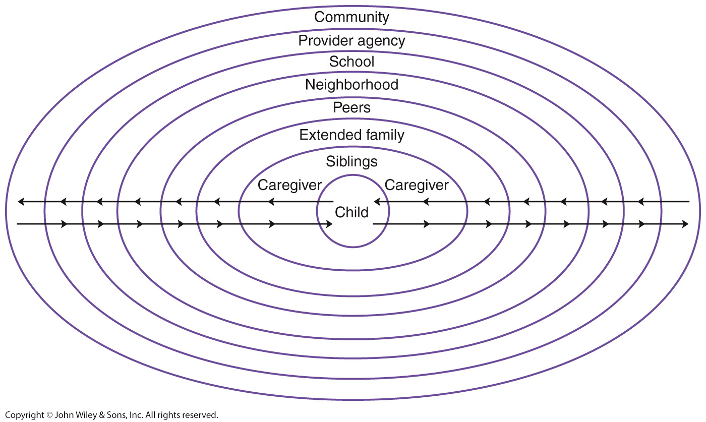
Multisystemic Treatment of CD>>.>

Slide 48
Depression and Anxiety in Children and Adolescents
Commonly co-occur with ADHD and CD
Also co-occur with each other
Early research suggested that depression and anxiety could be distinguished from each other in the same way they are in adults:
  Depression – high negative affect, low positive affect
  Anxiety – high negative affect but not low levels of positive affect
  More recent research calls this finding into question

Slide 49
Depression in Children and Adolescents…
Symptoms specific to children and adolescents
  Higher rates of suicide attempts and guilt
  Lower rates of
    Early morning awakening
    Early morning depression
    Loss of appetite
    Weight loss
Prevalence
  1% of preschoolers
  2 – 3% of school-age children
  6% of girls and 4% of boys during adolescence
Symptoms common to children, adolescents, and adults
  Depressed mood
  Inability to experience pleasure
  Fatigue
  Problems concentrating
  Suicidal ideation

Slide 50
Etiology of Depression in Children and Adolescents
Genetic factors
Early adversity and negative life events
Family and relationship factors
  A parent who is depressed
  Parental rejection only modestly associated with depression
  Children with depression and their parents interact in negative ways
    Less warmth
    More hostility

Slide 51
Etiology of Depression in Children and Adolescents…
Cognitive distortions internal mental filters or biases that increase our misery, fuel our anxiety, and make us feel bad about ourselves.) and negative attributional style
Stable attributional style (occurs when an individual believes an outcome will persist indefinitely )
  Develops by early adolescence
  By middle school, attributional style serves as a cognitive diathesis for depression
>>

Slide 52
Treatment of Depression in Children and Adolescents
  SSRIs more effective than tricyclics
  Meta-analysis studies showed medications most effective for anxiety other than OCD
    Less effective for depression and OCD
Concerns about medications
  Side effects including diarrhea, nausea, sleep problems, and agitation
  Possibility of increased risk of suicide attempts

Slide 53
Treatment of Depression in Children and Adolescents
Interpersonal psychotherapy (IPT)
  Focuses on peer pressures, transition to adulthood, and issues related to independence
CBT
  More effective for those with pretreatment, good coping skills, and recurrent depression
Psychotherapy generally only modestly effective with children and adolescents
  CBT no better than non-CBT therapies >>

Slide 54
Anxiety in Children and Adolescents
Fears and worries common in childhood
Anxiety disorder
  More severe and persistent worry
  Must interfere with functioning
Most childhood fears disappear but adults with anxiety disorders report feeling anxious as children
  “I’ve always been this way”
Prevalence
  3-5% of children and adolescents are diagnosed with anxiety disorder

Slide 55
Anxiety Disorders in Children…
    Separation anxiety disorder
  Worry about parental or personal safety when away from parents
  Typically first observed when child begins school
    Social anxiety disorder
  Extremely shy and quiet
  May exhibit selective mutism
    Refusal to speak in unfamiliar social setting

Slide 56
Anxiety Disorders in Children…
  Prevalence
    1% of children and adolescents
  Etiology
    Overestimation of threat
    Underestimation of coping ability
    Poor social skills
    >>

Slide 57
Post Traumatic Stress Disorder - PTSD
Exposure to trauma
  Chronic physical or sexual abuse
  Community violence
  Natural disasters
Symptom categories
  Flashbacks, nightmares, intrusive thoughts
  Avoidance
  Negative cognitions and moods
  Hyperarousal and vigilance
Some symptoms may differ from adults
  May exhibit agitation instead of fear or hopelessness

Slide 58
Obsessive Compulsive Disorder - OCD
Prevalence 1 to 4%
Symptoms similar to those in adults
Most common obsessions:
  Contamination from dirt and germs
  Aggression
  Thoughts about sex and religion more common in adolescence
OCD more common in boys than girls

Slide 59
Etiology of Anxiety Disorders
Genetics
  Heritability estimates from 29 – 50%
  Genetics plays a stronger role in separation anxiety in context of more negative life events
Parenting plays a small role in anxiety disorders

Slide 60
Etiology of Anxiety Disorders …
Emotion regulation and attachment problems also play a role
Perception of lack of acceptance by peers a factor in social phobia
Risk factors for PTSD include:
  Family stress and coping style
  Past experience with trauma

Slide 61
Treatment of Anxiety Disorders in
Childhood and Adolescence
Exposure to feared object
  Reward approach behavior
CBT - Coping Cat program - a cognitive-behavioral treatment for children with anxiety. The program incorporates 4 components: Recognizing and understanding emotional and physical reactions to anxiety. Clarifying thoughts and feelings in anxious situations Treatment includes education,
  coping skills training, and
  gradual exposure to anxiety inducing scenarios, as
  well as homework assignments. >>

Slide 62
Learning Disability
Evidence of inadequate development in a specific area of academic, language, speech or motor skills
  e.g., arithmetic or reading
Not due to mental retardation, autism, physical disorder, or lack of educational opportunity
Individual usually of average or above average intelligence
Often identified and treated in school
Reading disorders more common in boys >>

Slide 63
Specific Learning Disorder
DSM-5 Criteria for Specific Learning Disorder:
  Difficulties in learning basic academic skills (reading, mathematics, or writing) inconsistent with person’s age, schooling, and intelligence
  Significant interference with academic achievement or activities of daily living
Dyscalculia and dyslexia no longer distinct diagnoses
Specifiers include impairments in reading, written expression, and mathematics

Slide 64
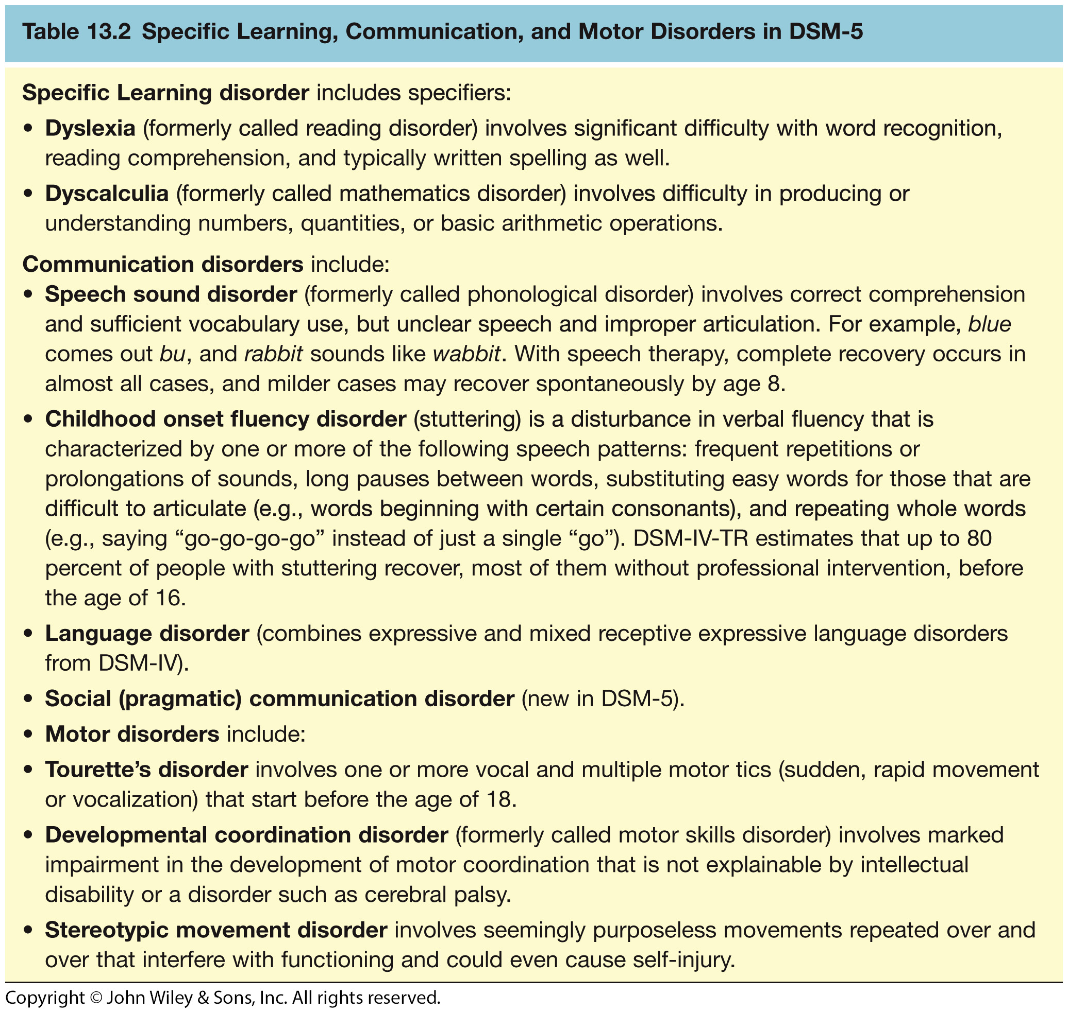
Learning, Communication, and Motor Disorders: DSM-5

Slide 65
Etiology of Learning Disabilities:
Impairment in Reading (Formerly Dyslexia)
Genetic factors
  Evidence from family and twin studies
  Genes are those associated with typical reading abilities (generalist genes)

Slide 66
Etiology of Learning Disabilities:
Impairment in Reading (Formerly Dyslexia)…
Problems in language processing
  Speech perception
  Analysis of sounds and their relationship to printed words
  Difficulty recognizing rhyme and alliteration
  Problems naming familiar objects rapidly
  Delays learning syntactic rules
  Deficient phonological awareness
    Inadequate left temporal, parietal, occipital activation

Slide 67
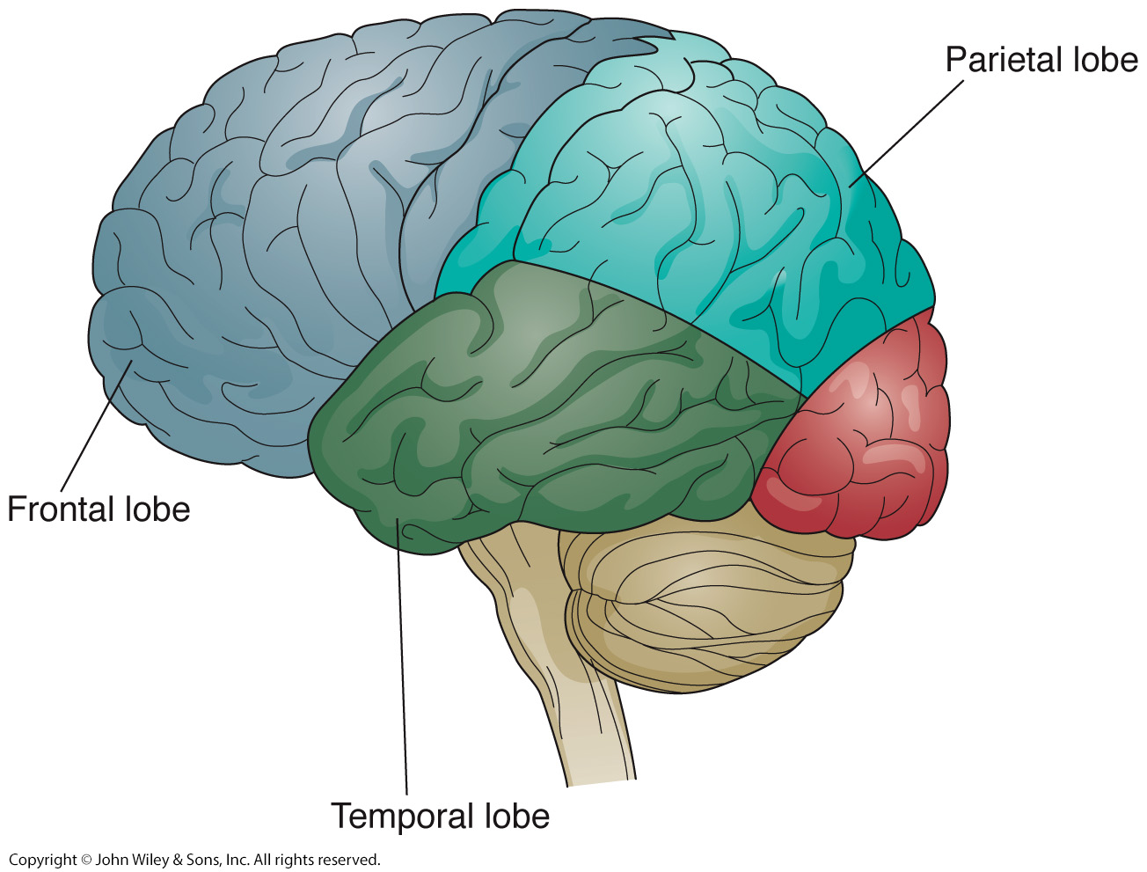
Areas of the Brain Implicated in Dyslexia: Frontal, Parietal, and Temporal Lobes

Slide 68
Etiology of Learning Disabilities: Impairment in Mathematics (Formerly Dyscalculia
Genetic and biological factors
  Evidence from twin studies suggest common genetic factors underlie both reading and math deficits
  Intraparietal sulcus implicated
  Has different cognitive deficits from dyslexia
  Children with only dyscalculia do not have deficits in phonological awareness

Slide 69
Treatment of Learning Disabilities
Reading and writing specifiers
  Multisensory instruction in listening, speaking, and writing skills
  Readiness skills in younger children as preparation for learning to read
  Phonics instruction
Communication disorders
    Involves computer games and audiotapes that slow speech sounds
>>

Slide 70
Intellectual Disability
(Intellectual Developmental Disorder)
Formerly called mental retardation in DSM-IV-TR
  Not preferred due to stigma
  Followed the guidelines of the American Association on Intellectual and Developmental Disabilities (AAIDD)
The AAIDD Definition of Intellectual Disability:
  Intellectual disability is characterized by significant limitations both in intellectual functioning and in adaptive behavior as expressed in conceptual, social, and practical adaptive skills
  .
…

Slide 71
Intellectual Disability
(Intellectual Developmental Disorder)
  This disability begins before age 18
  Five Assumptions Essential to the Application of the Definition
    Limitations in present functioning must be considered within the context of community environments typical of the individual’s age, peers, and culture
    Valid assessment considers cultural and linguistic diversity as well as differences in communication, sensory, motor, and behavioral factors
    Within an individual, limitations often coexist with strengths
    An important purpose of describing limitations is to develop profile of needed supports
    With appropriate personalized supports over a sustained period, the life functioning of the person with intellectual disability generally will improve

Slide 72
Intellectual Disability
(Intellectual Developmental Disorder
DSM-5 criteria:
  Intellectual deficits (e.g., in solving problems, reasoning, abstract thinking) determined by intelligence testing and broader clinical assessment
  Significant deficits in adaptive functioning relative to the person’s age and cultural group in one or more of the following areas: communication, social participation, work or school, independence at home or in the community, requiring the need for support at school, work, or independent life - Onset before age 18

Slide 73
Intellectual Disability
(Intellectual Developmental Disorder
DSM-5 changes:
  There is explicit recognition that an IQ score must be considered within the cultural context of a person
  Adaptive functioning must also be assessed and considered within the person’s age and cultural group
  No longer distinguish among mild, moderate, and severe ID based on IQ scores alone

Slide 74
Etiology of Intellectual Disability: Neurological Factors
Down syndrome
  Chromosomal trisomy 21: an extra copy of chromosome 21
  47 instead of 46 chromosomes
Fragile-X syndrome
  Mutation in the fMRI gene on the X chromosome
Recessive-gene disease
  Phenylketonuria (PKU)
Maternal infectious disease, especially during first trimester
  Cytomegalovirus, toxoplasmosis, rubella, herpes simplex, HIV, and syphilis
Lead or mercury poisoning

Slide 75
Treatment of Intellectual Disability
Residential treatment
  Small to medium-sized community residences
Behavioral treatments
  Language, social, and motor skills training
  Method of successive approximation to teach basic self-care skills in severely retarded
    e.g., holding a spoon, toileting
  Applied behavioral analysis: Understanding and changing behavior
Cognitive treatments
  Problem-solving strategies
Computer-assisted instruction
>>

Slide 76
Autism Spectrum Disorder
DSM-5 combines multiple diagnoses into one: Autism Spectrum Disorder:
  Autistic disorder,
  Asperger’s disorder,
  pervasive developmental disorder not otherwise specified, and
  childhood disintegrative disorder

Slide 77
Autism Spectrum Disorder …
  Research did not support distinctive categories
  Share similar clinical features; vary only in severity
  Specifiers include
    with or without accompanying intellectual impairment,
    language impairment,
    or catatonia

Slide 78
DSM-5 Criteria for
Autism Spectrum Disorder
A total of six or more items from A, B, and C below, with at least two from A and one each from B and C:

Slide 79
DSM-5 Criteria for
Autism Spectrum Disorder
A. Deficits in social communication and social interactions as manifested by all of the following:
Deficits in nonverbal behaviors such as eye contact, facial expression, body language
Deficit in development of peer relationships appropriate to developmental level
Deficits in social or emotional reciprocity such as not approaching others, not having a back-and-forth conversation, reduced sharing of interests and emotions

Slide 80
DSM-5 Criteria for
Autism Spectrum Disorder
B. Restricted, repetitive behavior patterns, interests, or activities manifested by at least two of the following:
Stereotyped or repetitive speech, motor movements, or use of objects
Excessive adherence to routines, rituals in verbal or nonverbal behavior, or extreme resistance to
change
Very restricted interests that are abnormal in focus, such as preoccupation with parts of objects
Hyper- or hypo-reactivity to sensory input or
unusual interest in sensory environment, such as fascination with lights or spinning objects

Slide 81
DSM-5 Criteria for
Autism Spectrum Disorder
C. Onset in early childhood
D. Symptoms limit and impair functioning

Slide 82
Autism Spectrum Disorder
Profound problems with the social world
  Rarely approach others, may look through people
  Problems in joint attention
  Pay attention to different parts of faces than do people without autism; focus on mouth, neglect eye region
  This neglect likely contributes to difficulties in perceiving emotion in other people

Slide 83
Autism Spectrum Disorder
Theory of mind (refers to the capacity to understand other people by ascribing mental states to them)
  Understanding that other people have different desires, beliefs, intentions, and emotions
  Crucial for understanding and successfully engaging in social interactions
  Typically develops between 2½ and 5 years of age
  Children with ASD seem not to achieve this developmental milestone

Slide 84
Autism Spectrum Disorder
Communication deficits
  Children with ASD evidence early language disturbances
  Echolalia: immediate or delayed repeating of what was heard
  Pronoun reversal: refer to themselves as “he” or “she”
  Literal use of words
Repetitive and ritualistic acts
  Become extremely upset when routine is altered
  Engage in obsessional play
  Engage in ritualistic body movements
  Become attached to inanimate objects (e.g., keys, rocks)

Slide 85
Autism Spectrum Disorder
Comorbidity
  IQ < 70 is common
    Children with intellectual developmental disorder score poorly on all parts of an IQ test; children with ASD score poorly on those subtests related to language, such as tasks requiring abstract thought, symbolism, or sequential logic
Prevalence
  1 out of 110 children
  Found in all SES, ethnic, and racial groups
  Diagnosis of ASD is remarkably stable
Prognosis: Children with higher IQs who learn to speak before age six have the best outcomes

Slide 86
Etiology of Autistic Spectrum Disorder
Genetic factors
  heritability estimates of around 80%
  Twin studies
    47 to 90% concordance rates for MZ twins; 0-20% for DZ twins
  Genetic flaw
    Deletion on chromosome 16

Slide 87
Etiology of Autistic Spectrum Disorder
Neurobiological factors
  Brain size
    Although normal size at birth, brains of autistic adults and children are larger than normal
    Pruning of neurons may not be occurring
  “Overgrown” areas include the frontal, temporal, and cerebellar, which have been linked with language, social, and emotional functions
  Abnormally sized amygdalae predicted more difficulties in social behavior and communication

Slide 88
Treatment of
Autistic Spectrum Disorder
Psychological treatments more promising than drugs
Earlier treatment associate with better outcomes
Intensive operant conditioning
  Dramatic and encouraging results
Parent training and education
Pivotal response treatment
  Focus on increasing child’s motivation and responsiveness rather than on discrete behaviors

Slide 89
Treatment of
Autistic Spectrum Disorder
Joint attention intervention and symbolic play used to improve attention and expressive skills
Medication used to treat problem behaviors
  Haloperidol (Haldol)
    Antipsychotic
    Reduces aggression and stereotyped motor behavior
    Does not improve language and interpersonal relationships
    >>>

Slide 90
THANKS

